Slide 1
Yalamanda Vanama
September 2014
Product Maintenance Training (PMT)
IBM Case Manager 5.2.1 and
IBM Case Manager Platform Installation Tool 5.2.1
Install & Prerequisites

Slide 2
Introduction
Target Audience:
  Primarily Support (L2) and Lab Services
  Personnel working with IBM Case Manager customers such as Sales System Engineers, Specialists and SMEs, Consulting Specialists, Field Technical Consultants and Technical Support
  Anyone who wants a complete IBM Case Management system on a single server for development, testing or POC
Prerequisites:
  Familiarity with the installation, configuration, and functionality of the P8 Platform
  High level knowledge of IBM FileNet P8 Platform
  Knowledge of FileNet P8 engines (ICN, CPE, etc.) is a plus
Version Release Date: Q3, 2014

Slide 3
Course Objective
After this course you will be able to
  Identify the prerequisites for Case Manager 5.2.1
  Install Case Manager 5.2.1
  Uninstall Case Manager 5.2.1
  Install and configure a complete Case Manager system using the IBM Case Management Platform Installation Tool (CMPIT)
  Troubleshoot installation problems
  Access Case Management reference and help materials

Slide 4
Course Roadmap
  Case Manager Prerequisites
  Case Manager Installer Review
  Case Manager Server Installation Walk-through
  How to uninstall Case Manager
  Case Manager Log Locations
  CMPIT Prerequisites
  CMPIT Review
  CMPIT New Features
  CMPIT Best Practices
  CMPIT Important Note
  Troubleshoot section / Use cases
  Reference Materials

Slide 5
ICM 5.2.1 – Prerequisites (Core Components)
ICM 5.2.1 Core Prerequisites -
  IBM FileNet P8
  IBM Content Navigator
  IBM Workplace XT

Slide 6
Course Roadmap
  Case Manager Prerequisites
  Case Manager Installer Review
  Case Manager Server Installation Walk-through
  How to uninstall Case Manager
  Case Manager Log Locations
  CMPIT Prerequisites
  CMPIT Review
  CMPIT New Features
  CMPIT Best Practices
  CMPIT Important Note
  Troubleshoot section / Use cases
  Reference Materials

Slide 7
ICM 5.2.1 - What is changed?
  Allow Side by Side Installation with ICM 5.1.1.
  If the user wants to overwrite ICM5.1.1 installed location, warns the user but does not prevent the user from installing
  Upgrade from previous releases supported (5.1.1 and 5.2.0)

Slide 8
Course Roadmap
  Case Manager Prerequisites
  Case Manager Installer Review
  Case Manager Server Installation Walk-through
  How to uninstall Case Manager
  Case Manager Log Locations
  CMPIT Prerequisites
  CMPIT Review
  CMPIT New Features
  CMPIT Best Practices
  CMPIT Important Note
  Troubleshoot section / Use cases
  Reference Materials

Slide 9
ICM 5.2.1 – Install Executable
OS | Version | Installer Executables
AIX | 6.1, 7.1 | 5.2.1.0-ICM-AIX.BIN
Linux (x86) | - 5.4.x, 6.x (RHEL) - 11 (SLES) | 5.2.1.0-ICM-LINUX.BIN
Linux System z | - 5.4.x, 6.x (RHEL) - 11 (SLES) | 5.2.1.0-ICM-ZLINUX.BIN
Windows | 2008 R2, Win 2012 | 5.2.1.0-ICM-WIN.EXE
Solaris | 10 | 5.2.1.0-ICM-SOLARIS.BIN
Refer to the software product compatibility reports (SPCR) for all complete list of the supported hardware and software requirements for Case Manager 5.2.1.
http://pic.dhe.ibm.com/infocenter/prodguid/v1r0/clarity/index.html

Slide 10
ICM 5.2.1 – Prerequisite Checking: XT
Workplace XT checking is performed first.
Prerequisite Checking
XT Not Installed
XT < 1.1.5.2
XT => 1.1.5.2
Minimum Workplace XT version required is 1.1.5.2.

Slide 11
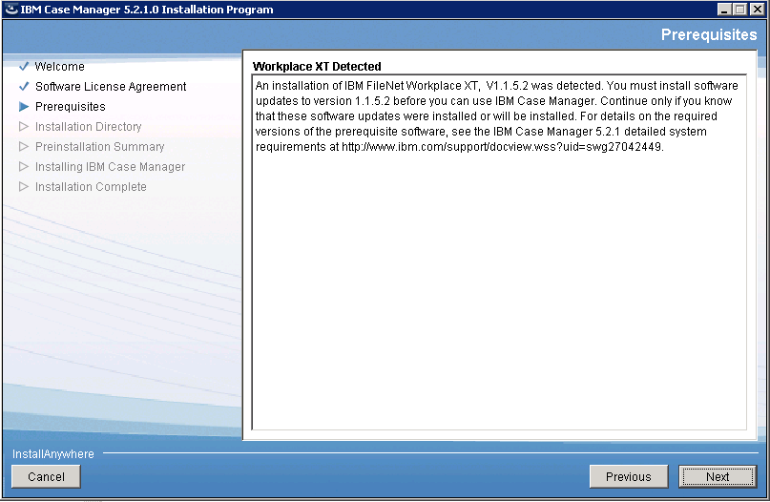
ICM 5.2.1 – Prerequisite Checking: XT

Slide 12
ICM 5.2.1 – Prerequisite Checking: ICN
Prerequisite Checking
ICN Not Installed
ICN < 2.0.3
ICN => 2.0.3
Minimum IBM Content Navigator (ICN) version required is 2.0.3.
ICN can be installed locally with IBM Case Manager under the same or a different WebSphere profile or in a remote WebSphere profile

Slide 13
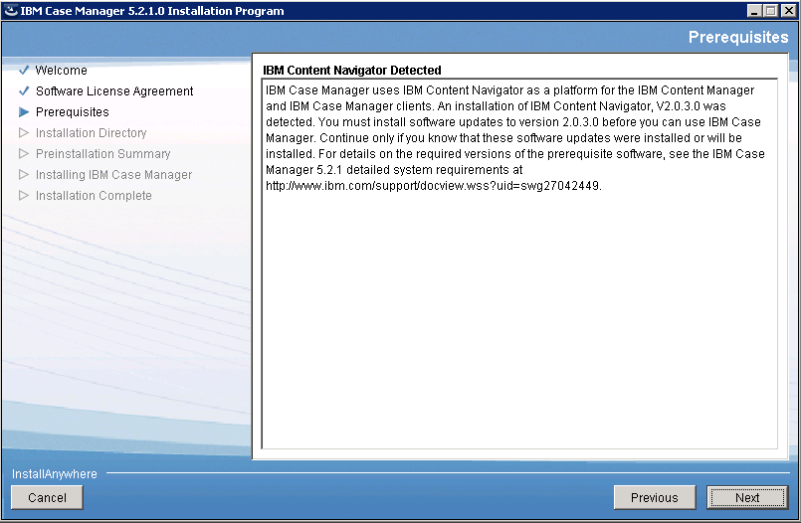
  ICM 5.2.1 – Prerequisite Checking: ICN

Slide 14
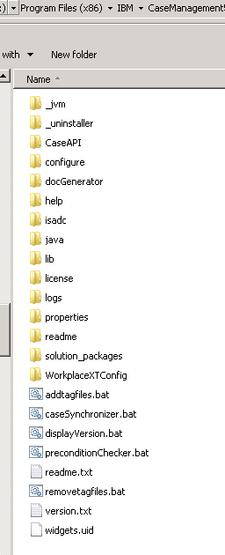
ICM 5.2.1 – ICM Directory Structure

Slide 15
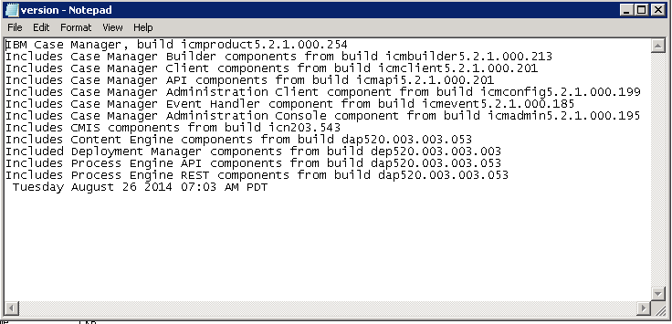
ICM 5.2.1 – What components were installed?
The component version shown in this graphic is subject to change. The version listed is not finalized.

Slide 16
ICM 5.2.1 – Post Install Action
During post installation phase, the installer copies the debug logs to
InstallDebug folder
Under <ICM_INSTALL_FOLDER>/logs directory

Slide 17
Course Roadmap
  Case Manager Prerequisites
  Case Manager Installer Review
  Case Manager Server Installation Walk-through
  How to uninstall Case Manager
  Case Manager Log Locations
  CMPIT Prerequisites
  CMPIT Review
  CMPIT New Features
  CMPIT Best Practices
  CMPIT Important Note
  Troubleshoot section / Use cases
  Reference Materials

Slide 18
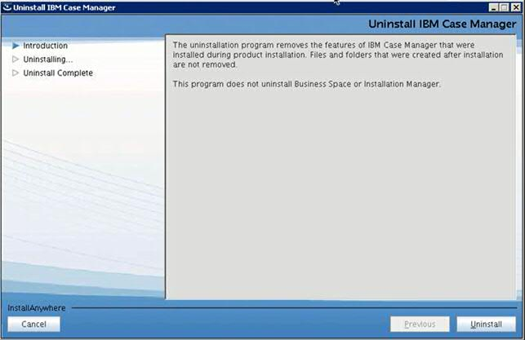
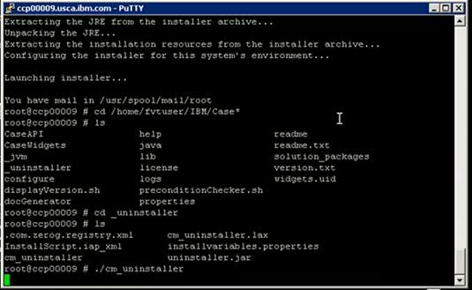
ICM 5.2.1 – How to start ICM 5.2.1 uninstaller
1. cd to <ICM Install Folder>/_uninstaller
2. Execute cm_uninstaller

Slide 19
Course Roadmap
  Case Manager Prerequisites
  Case Manager Installer Review
  Case Manager Server Installation Walk-through
  How to uninstall Case Manager
  Case Manager Log Locations
  CMPIT Prerequisites
  CMPIT Review
  CMPIT New Features
  CMPIT Best Practices
  CMPIT Important Note
  Troubleshoot section / Use cases
  Reference Materials

Slide 20
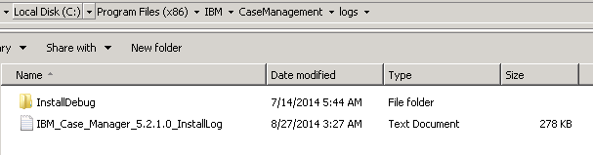
ICM 5.2.1 – Log locations
Install Logs | Unix - /opt/IBM/CaseManagement/logs/IBM_Case_Manager_5.2.1.0_InstallLog.txt Windows - drive:\Program Files\IBM\CaseManagement\logs\IBM_Case_Manager_5.2.1.0_InstallLog.txt
Install Debug Logs | In the same logs path as above and the logs are in “InstallDebug” directory

Slide 21
Course Roadmap
  Case Manager Prerequisites
  Case Manager Installer Review
  Case Manager Server Installation Walk-through
  How to uninstall Case Manager
  Case Manager Log Locations
  CMPIT Prerequisites
  CMPIT Review
  CMPIT New Features
  CMPIT Best Practices
  CMPIT Important Note
  Troubleshoot section / Use cases
  Reference Materials

Slide 22
CMPIT Prerequisites - AIX
Installation must be performed by the root user (Tivoli Directory Server requirement)
The system must be a clean system (i.e. without TDS, DB2, WAS, P8 pre-installed)
Hardcoded device (must have /opt device)
/opt must have minimum of 30 GB of free disk space
/tmp and /home must have minimum 3GB of free disk space each
Minimum RAM = 6GB
Utility gunzip must be installed and in the machine path
Utility unzip must be installed (unzip package can be downloaded at: http://www-03.ibm.com/systems/power/software/aix/linux/toolbox/ezinstall.html
The required packages should be staged on the locally mounted file system

Slide 23
CMPIT Prerequisites - Linux
Installation must be performed by the root user (Tivoli Directory Server requirement)
The system must be a clean system (i.e. without TDS, DB2, WAS, P8 pre-installed)
Hardcoded device (must have /opt device)
/opt must have minimum of 30 GB of free disk space
Minimum RAM = 6GB
Required 64-bit/32-bit packages that must be preinstalled on your Linux server http://publib.boulder.ibm.com/infocenter/wasinfo/v6r1/topic/com.ibm.websphere.express.doc/info/exp/ae/tins_linuxsetup_rhel5.html
  compat-libstdc++-33-3.2.3-61
  compat-db-4.2.52-5.1
  libXp-1.0.0-8
  libXmu-1.0.2-5
  libXtst-1.0.1-3.1
  pam-0.99.6.2-3.26.el5
  libXft-2.1.10-1.1

Slide 24
CMPIT Prerequisites - Linux
unzip and gunzip utilities must be installed
If SElinux is set to Enforce, you will not be able to execute the installer.
  You can only execute the installer if the SElinux is set to permissive or disabled.
  You can temporarily change the SElinux to permissive by executing this command
echo 0 >/selinux/enforce
The required packages should be staged on the locally mounted file system

Slide 25
CMPIT Prerequisites - Windows
Must log on as the local administrator
Disable “User Account Control (UAC)” before running CMPIT. Once CMPIT is completed successfully, you may re-enable UAC
http://technet.microsoft.com/en-us/library/cc709691%28WS.10%29.aspx#BKMK_S3
The system must be a clean system (i.e. without TDS, DB2, WAS, P8 pre-installed)
C:\ must have a minimum of 30 GB of free disk space
Minimum RAM = 6GB
Web Services Enhancements 3.0 for Microsoft .NET redistributable runtime must be pre-installed. http://www.microsoft.com/downloads/details.aspx?FamilyID=9e59c3fb-e7bc-4d91-908e-411a8d329f3d&displaylang=en
The required packages must be staged on the local disk

Slide 26
Course Roadmap
  Case Manager Prerequisites
  Case Manager Installer Review
  Case Manager Server Installation Walk-through
  How to uninstall Case Manager
  Case Manager Log Locations
  CMPIT Prerequisites
  CMPIT Review
  CMPIT New Features
  CMPIT Best Practices
  CMPIT Important Note
  Troubleshoot section / Use cases
  Reference Materials

Slide 27
CMPIT - Review
  Installs and configures a complete IBM Case Management system on a single server
  Runs on 64-bit AIX, RedHat Enterprise Linux, and Windows
  Supports both interactive (GUI) and non-interactive (silent) install
  Cannot be used to upgrade an existing CMPIT installation – instead follow the upgrade instructions for a distributed system that are provided in the Case Manager Knowledge Center

Slide 28
CMPIT Installation Flow - Review
  Log on as root (UNIX) or local administrator (Windows)*
  Download the required software packages to the local drive/volume
  http://g01zciwas018.ahe.pok.ibm.com/support/dcf/preview.wss?host=g01zcidbs003.ahe.pok.ibm.com&db=support/swg/swgdnld.nsf&unid=0583E3BF92C50F3885257D0F00625E24&taxOC=SSCBUSM&MD=2014/08/25%2012:08:28&sid=
  Rename the packages following the instructions in the Knowledge Center for performing a single-server installation
  Accept licenses by editing the CMPIT.properties file to change the LICENSE_ACCEPTED_# parameter to TRUE
  Run the CMPIT tool
  Verify system. Refer to accounts.txt (in /opt/IBM/CMPIT or C:\Program Files (x86)\IBM\CMPIT) for additional information

Slide 29
Course Roadmap
  Case Manager Prerequisites
  Case Manager Installer Review
  Case Manager Server Installation Walk-through
  How to uninstall Case Manager
  Case Manager Log Locations
  CMPIT Prerequisites
  CMPIT Review
  CMPIT New Features
  CMPIT Best Practices
  CMPIT Important Note
  Troubleshoot section / Use cases
  Reference Materials

Slide 30
CMPIT New Features
Required Packages
      TDS 6.3
      WAS 8.5.5
      DB2 9.7 FP5
      DB2 Restricted License
      CPE 5.2.0 FP3
      CPE 5.2.0 FP3 IF003
      CPE Client 5.2.0 FP3
      CPE Client 5.2.0 FP3 IF003
      ICF 5.2.0
      ICF 5.2.0 FP002
      ICN 2.0.3
      XT 1.1.5.2 IF001
      ICM 5.2.1
http://g01zciwas018.ahe.pok.ibm.com/support/dcf/preview.wss?host=g01zcidbs003.ahe.pok.ibm.com&db=support/swg/swgdnld.nsf&unid=0583E3BF92C50F3885257D0F00625E24&taxOC=SSCBUSM&MD=2014/08/25%2012:08:28&sid=

Slide 31
Course Roadmap
  Case Manager Prerequisites
  Case Manager Installer Review
  Case Manager Server Installation Walk-through
  How to uninstall Case Manager
  Case Manager Log Locations
  CMPIT Prerequisites
  CMPIT Review
  CMPIT New Features
  CMPIT Best Practices
  CMPIT Important Note
  Troubleshoot section / Use cases
  Reference Materials

Slide 32
CMPIT 5.2.1 – Best Practices
Prior to installation, back up the system
On Windows only:
  Turn off system/security auto updates to avoid downloads occurring during CMPIT installation as they may cause CMPIT to timeout
  Set Maximum password Age (in Local Security Policy) to zero to prevent local accounts from being expired
  Start->Administrative tools -> Local Security Policy -> Security Settings -> Account Policies -> Password Policy -> Maximum password Age
After installation, read accounts.txt and readme.txt
  The default locations are:
  UNIX: /opt/IBM/cmpit
  Windows: C:\Program Files (x86)\IBM\cmpit
  Use the pwdreset script to clear passwords from the installation logs and scripts
  Refer to the readme.txt file for more information
  Secure or delete the accounts.txt file

Slide 33
Course Roadmap
  Case Manager Prerequisites
  Case Manager Installer Review
  Case Manager Server Installation Walk-through
  How to uninstall Case Manager
  Case Manager Log Locations
  CMPIT Prerequisites
  CMPIT Review
  CMPIT New Features
  CMPIT Best Practices
  CMPIT Important Note
  Troubleshoot section / Use cases
  Reference Materials

Slide 34
CMPIT 5.2.1 – Important Note
In the CMPIT.properties file, do not update the PROCESSED_X status for the “pwdset” and “updatehostname” scripts. The values must be set to NO before running CMPIT

Slide 35
Course Roadmap
  Case Manager Prerequisites
  Case Manager Installer Review
  Case Manager Server Installation Walk-through
  How to uninstall Case Manager
  Case Manager Log Locations
  CMPIT Prerequisites
  CMPIT Review
  CMPIT New Features
  CMPIT Best Practices
  CMPIT Important Note
  Troubleshoot section / Use cases
  Reference Materials

Slide 36
ICM 5.2.1 - Troubleshooting
Scenario 1:
I do not have XT, ICN installed, can I continue with ICM 5.2.1 installer?
Yes. But you are encouraged to install proper prerequisites before running the ICM 5.2.1 Installer.
ICM 5.2.1 installer provides warnings if you do not have necessary prerequisites installed but will not prevent you from completing the ICM installation.
You must have the required prerequisites installed before you start configuring Case Manager.

Slide 37
ICM 5.2.1 - Troubleshooting
Scenario 2:
Can I install ICM with non-root users on Unix platforms?
Yes. You can install ICM using a non root user on Unix platforms.

Slide 38
CMPIT 5.2.1 - Troubleshooting
If errors occur during the installation, review the following installation logs in the <installation_path> directory for more information, and correct the error as appropriate:
  cmpit521_install_stdout.txt (CMPIT’s main log - found in UNIX: /tmp, Windows: %TEMP%)
  cmpit521_install_stderr.txt (found in UNIX: /tmp, Windows: %TEMP%)
  cmpit521_install_log.txt (found in /opt/IBM/cmpit C:\Program Files (x86)\IBM\cmpit)
After installation, these logs can be found in <installation_path>
  UNIX: /opt/IBM/CMPIT,
  Windows: C:\Program Files (x86)\IBM\CMPIT
"CHECK_DISK_SPACE" - Set it to "OFF“ to bypass disk space checking (case sensitive)
Format: <installer-name> -DCHECK_DISK_SPACE=OFF [-f cmpit_silent_install.txt]
Ex: ./5.2.1-CMPIT-LINUX.BIN –DCHECK_DISK_SPACE=OFF

Slide 39
CMPIT 5.2.1 - Troubleshooting UNIX
installTDS failed:
  Check install logs at: /opt/IBM/cmpit/install-scripts/log, /opt/ibm/ldap/V6.3/var, /opt/ibm/tdsV6.3db2/install/logs
  Correct the TDS or DB2 installation error accordingly (may need to uninstall TDS/DB2), then configure CMPIT to continue where it left off
Out of disk space in /tmp:
  Increase /tmp disk space if possible: Ex /usr/sbin/chfs -a size=3G /tmp
  Redirect /tmp directory to another available volume by execute the following commands,
  IATEMPDIR=/opt/IBM/cmpit/decompressed
  export IATEMPDIR
unpack failed due to unzip not installed:
  Download and Install unzip package (May download unzip package for AIX from http://www-03.ibm.com/systems/power/software/aix/linux/toolbox/ezinstall.html
  Restart CMPIT

Slide 40
CMPIT 5.2.1 - Troubleshooting Windows
createP8Domain failed due to WAS not restarted properly:
  Restart WAS using Windows’ Administrative Tools -> Services
  Execute CMPIT’s “createP8Domain” script
Ex*: /opt/IBM/cmpit/install-scripts/createP8Domain.sh /opt/IBM/cmpit/install-scripts /opt/IBM/cmpit/decompressed /opt/cmpit-linux 32 /opt/IBM/cmpit
createP8Domain failed due to Windows WSE 3.0 run-time not yet installed:
  Download and install Windows WSE 3.0 runtime and reboot the system
  Execute CMPIT’s “createP8Domain” script
Ex*: /opt/IBM/cmpit/install-scripts/createP8Domain.sh /opt/IBM/cmpit/install-scripts /opt/IBM/cmpit/decompressed /opt/cmpit-linux 32 /opt/IBM/cmpit
* See actual command line format in your stdout log for line starts with “cmd:” immediately after line starts with “invokeScript:”

Slide 41
Course Roadmap
  Case Manager Prerequisites
  Case Manager Installer Review
  Case Manager Server Installation Walk-through
  How to uninstall Case Manager
  Case Manager Log Locations
  CMPIT Prerequisites
  CMPIT Review
  CMPIT New Features
  CMPIT Best Practices
  CMPIT Important Note
  Troubleshoot section / Use cases
  Reference Materials

Slide 42
Contacts
Product Marketing Manager:
    William D. (Doc) Mills (wdocmills@us.ibm.com)
Product Manager:
    Dave Perman (dperman@ca.ibm.com)
Subject Matter Experts (SME)/Area of Expertise:
    Yalamanda Vanama (yalamanda@in.ibm.com)
    Manu Kuchhal (manukuchhal@in.ibm.com)
    Paul Mac Alpine (psmacalp@us.ibm.com)
    Abrar Khan (abrakhan@us.ibm.com)
Product Support Manager:
    Ted Dullanty (tdullanty@us.ibm.com)

Slide 43
Product Help/Documentation/Resources
Case Manager 5.2.1 Knowledge Center
http://www-01.ibm.com/support/knowledgecenter/SSCTJ4_5.2.1/com.ibm.casemgmttoc.doc/casemanager_5.2.1.htm
P8 5.2 Knowledge Center
http://www-01.ibm.com/support/knowledgecenter/SSNW2F_5.2.0/com.ibm.p8toc.doc/filenetcontentmanager_5.2.0.htm

